Slide 1
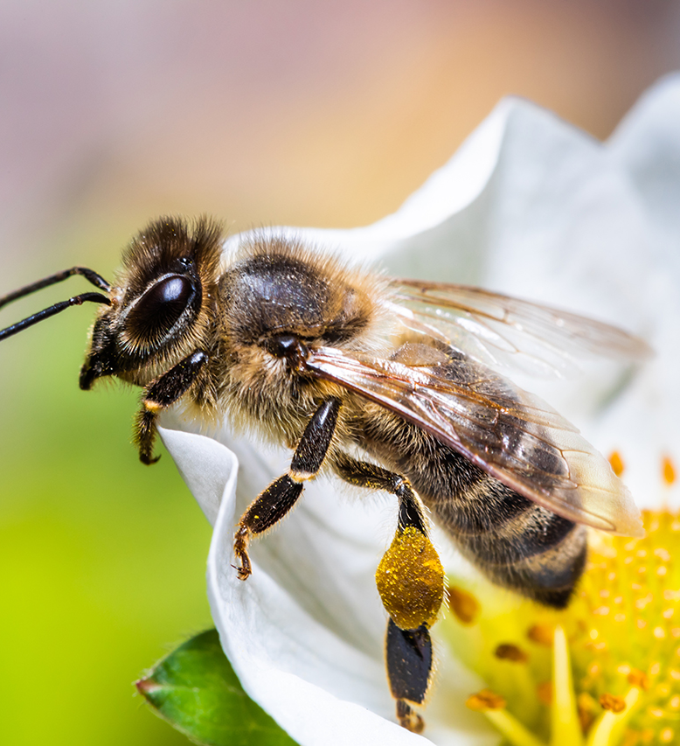
The Vital Role of Bees in Our Environment
Notes:
Bees play a crucial role in our ecosystem by pollinating plants that provide food and habitat for wildlife. They are responsible for pollinating 30% of the world's food crops and 90% of wild plants.

Slide 2
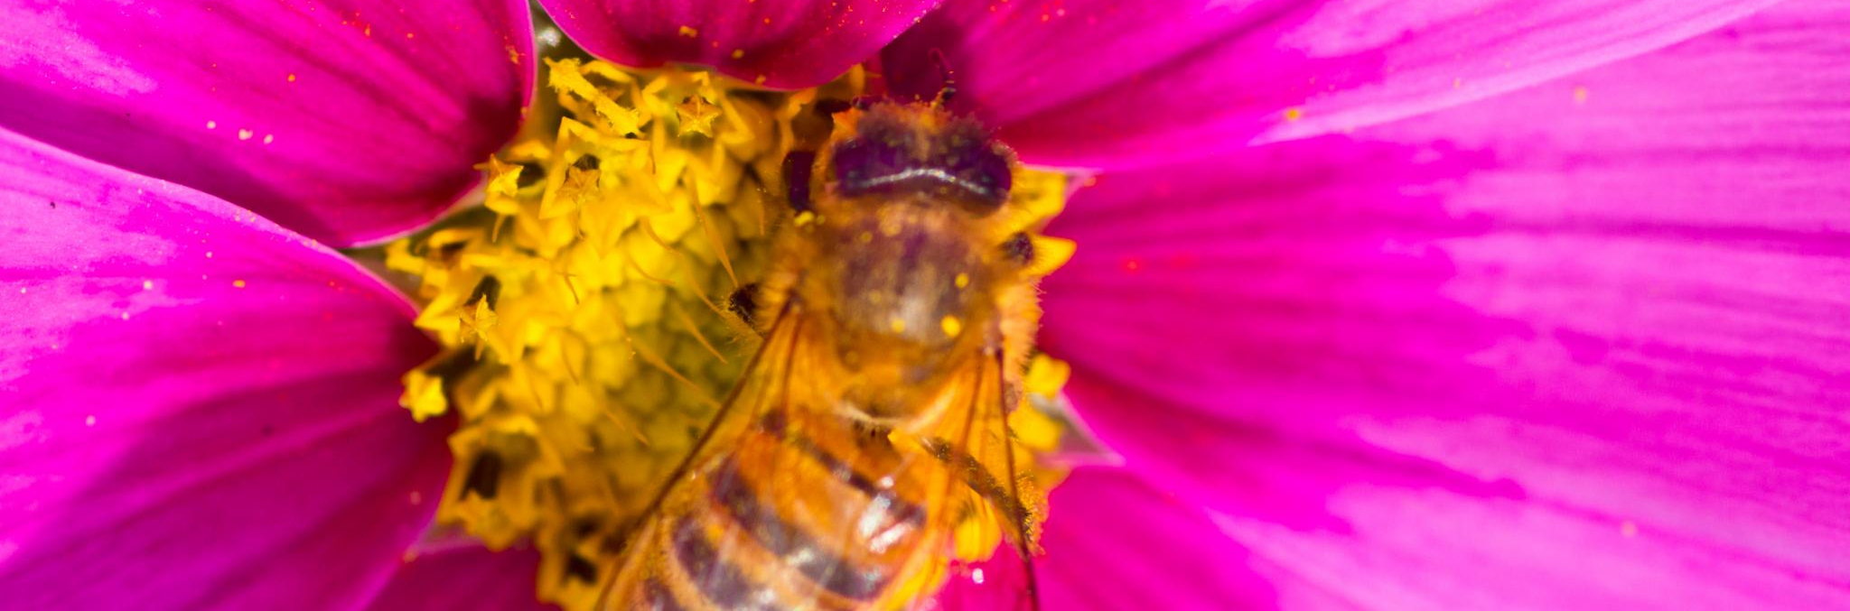
Bee Decline and Its Impact
Bee populations have been declining rapidly in recent years due to climate change, habitat loss, and pesticide use.
This decline has a significant impact on our food supply and the environment.
Without bees, many crops would not be able to produce fruit or seeds.
This would lead to a decrease in the variety and quantity of food available, as well as a decline in wildlife populations that rely on these plants for food and habitat.
Notes:
The decline in bee populations is a serious concern because of their vital role in pollinating crops and plants that are essential to our food supply and the environment. Without bees, we would lose many of the foods we eat and the plants that provide habitat for other wildlife.

Slide 3
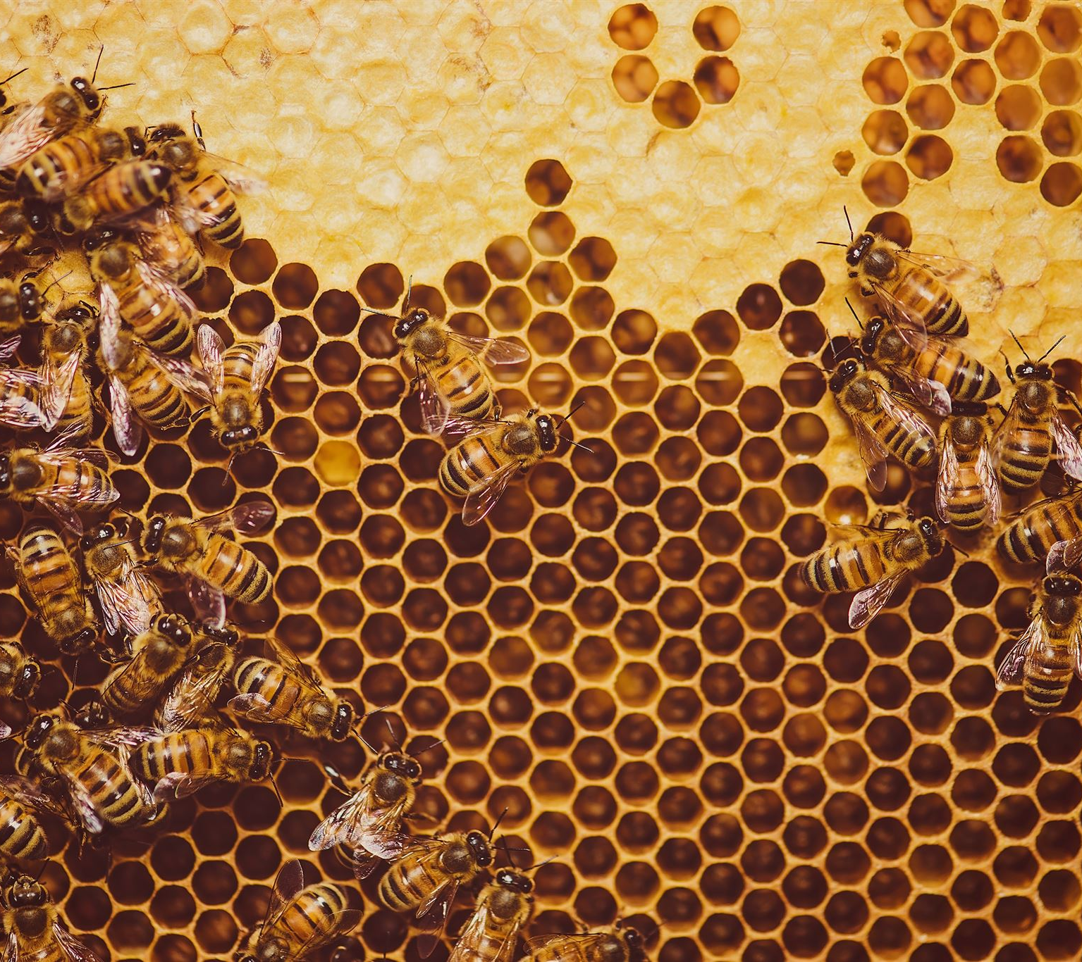
The Importance of Bee Conservation
Conserving bees is essential for maintaining healthy ecosystems and a sustainable food supply.
There are many ways to support bee conservation, including planting pollinator-friendly plants, reducing pesticide use, and supporting local beekeepers.
Small actions can make a big difference in protecting these important pollinators.
Notes:
Conserving bees is essential for maintaining healthy ecosystems and a sustainable food supply. Everyone can help by planting pollinator-friendly plants, reducing pesticide use, and supporting local beekeepers. These small actions can make a big difference in protecting these important pollinators.

Slide 4

The Role of Bees in Agriculture
Bees are an essential part of agriculture, pollinating crops that provide food for people and livestock.
Without bees, farmers would not be able to produce many of the foods we eat, including fruits, vegetables, and nuts.
Bee pollination also improves crop yields and quality, leading to increased profits for farmers.
The economic value of bee pollination is estimated at billions of dollars worldwide.
Notes:
Bees are critical to agriculture, pollinating crops that provide food for people and livestock. Without bees, farmers would not be able to produce many of the foods we eat, including fruits, vegetables, and nuts. Bee pollination also improves crop yields and quality, leading to increased profits for farmers. The economic value of bee pollination is estimated at billions of dollars worldwide.

Slide 5
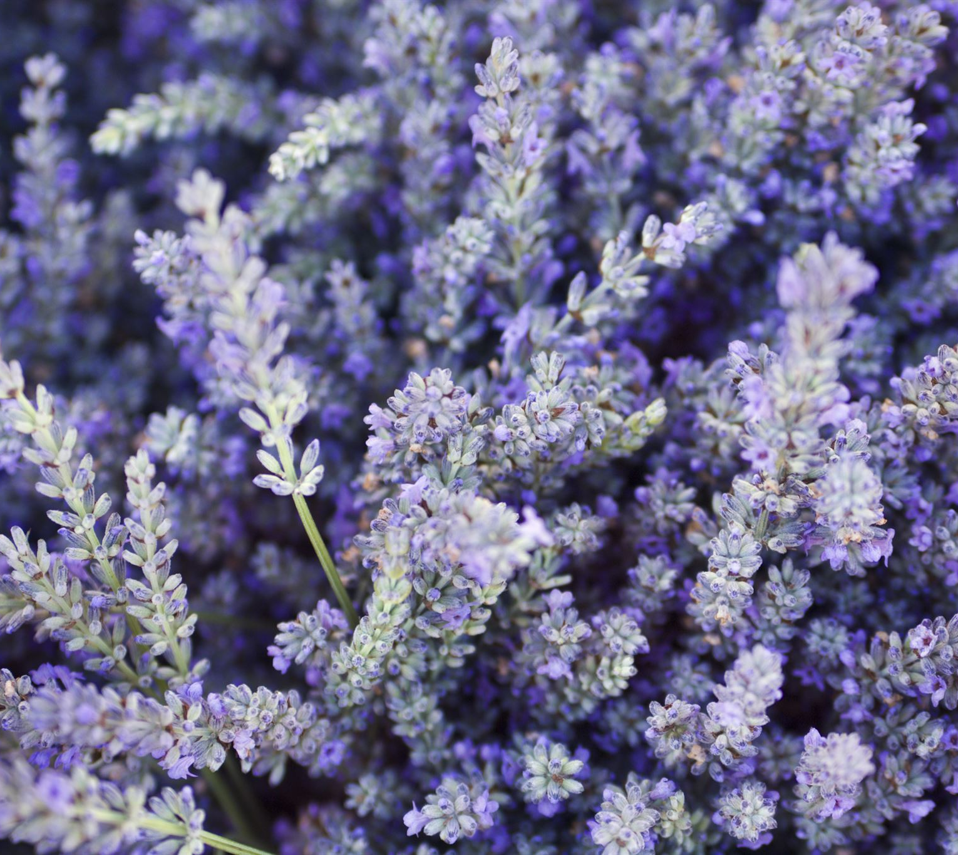
The Future of Bees
The future of bees is uncertain, but there are many ways we can help protect these important pollinators.
Reducing pesticide use, planting pollinator-friendly plants, and supporting beekeepers are all important steps in conserving bees.
It is up to all of us to take action to protect bees and the vital role they play in our environment and food supply.
Notes:
The future of bees is uncertain, but there are many ways we can help protect these important pollinators. Reducing pesticide use, planting pollinator-friendly plants, and supporting beekeepers are all important steps in conserving bees. It is up to all of us to take action to protect bees and the vital role they play in our environment and food supply.

